Slide 1
Machine Learning for data science and business intelligence – 8IAR403
By Kévin Bouchard Ph.D.
Professor in artificial intelligence & machine learning
Laboratoire d'Intelligence Ambiante pour la reconnaissance d'activités (LIARA)
Université du Québec à Chicoutimi
www.Kevin-Bouchard.ca

Slide 2

Summary of lesson #11
You will learn about:
Regularization
Non-Linear regression models
Common evaluation measures

Slide 3
Regularization
Regularization in machine learning is a technique used to prevent overfitting
A model performs well on training data but poorly on unseen data
With regression, only a problem if we have outliers! (i.e: mathematical regression often has an exact solution)
The main idea is to introduce additional information (a penalty) to impose simplicity, smoothness, or other constraints on the model
We have briefly mentioned it with logistic regression and SVM
Popular methods:
Ridge Regression
Least Shrinkage and Selection Operator
Elastic Net

Slide 4

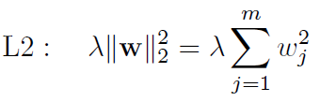

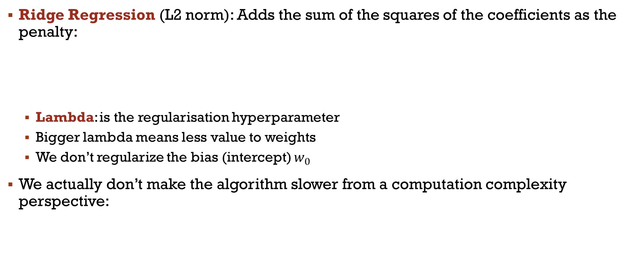
Regularization
Ridge Regression (L2 norm): Adds the sum of the squares of the coefficients as the penalty:
Lambda: is the regularisation hyperparameter
Bigger lambda means less value to weights
We don’t regularize the bias (intercept) $w_{0}$
We actually don’t make the algorithm slower from a computation complexity perspective:

Slide 5


Regularization
LASSO(L1 norm): adds the sum of the absolute values of the coefficients as the penalty to the loss function
It encourages sparsity, meaning it can lead to some coefficients being exactly zero
This is basically feature selection
https://scikit-learn.org/stable/modules/feature_selection.html#l1-feature-selection
If the dimensionality is much bigger than the number of training sample, many features are eliminated
Depending on gamma value too!

Slide 6
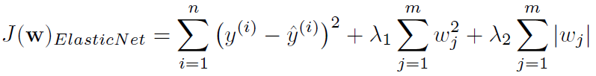

Regularization
Elastic Net: Both L1 and L2 regularization can be combined, which is useful when there are multiple correlated features.
L1 norm→ for high sparsity
L2 norm→ to select more features than LASSO
Useful when several attributes are correlated with each other
The implementation in Scikit Learn adds a ratio (hyperparameters)
Notes:
Tell them it is most common with neural net

Slide 7
Non-Linear regression
In reality, what we saw with SVM, the kernel trick, can be applied to pretty much any algorithm to turn them in a non-linear version
We’ll now talk a bit about additional options to do so

Slide 8
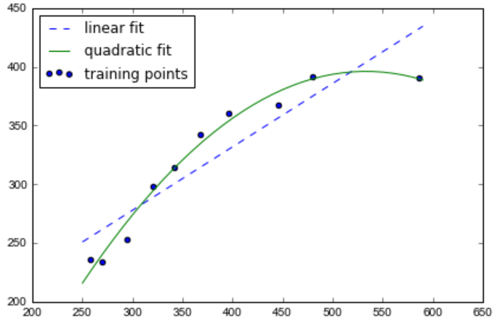
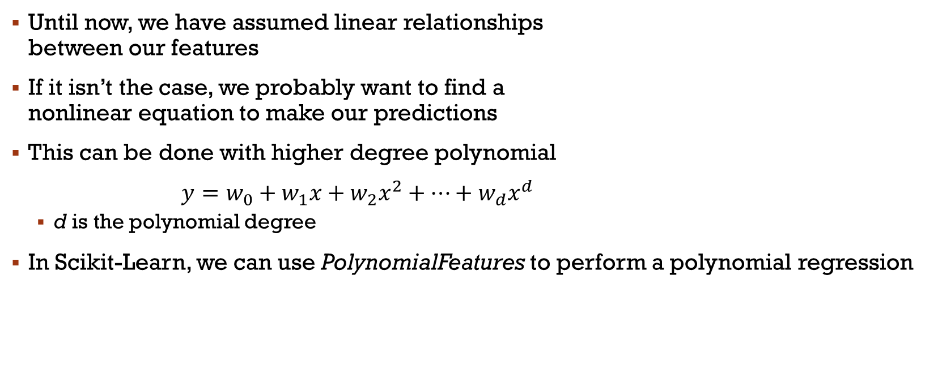
Polynomial regression
Until now, we have assumed linear relationships between our features
If it isn’t the case, we probably want to find a nonlinear equation to make our predictions
This can be done with higher degree polynomial
$y=w_{0}+w_{1}x+w_{2}x^{2}+…+w_{d}x^{d}$
d is the polynomial degree
In Scikit-Learn, we can use PolynomialFeatures to perform a polynomial regression
Notes:
Voir exemple de code

Slide 9
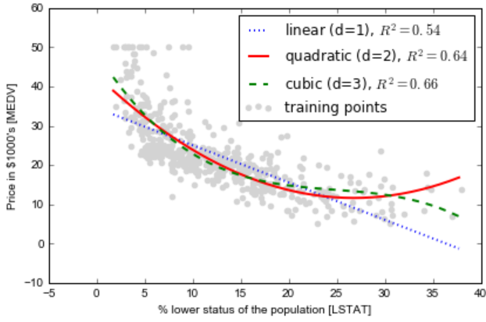
Polynomial regression
Let us look at the sample code from “Housing – polynomial”
What are our conclusions regarding that code?
Notes:
Choix, + simple, sinon overfitting
R^2: Coefficient de détermination

Slide 10

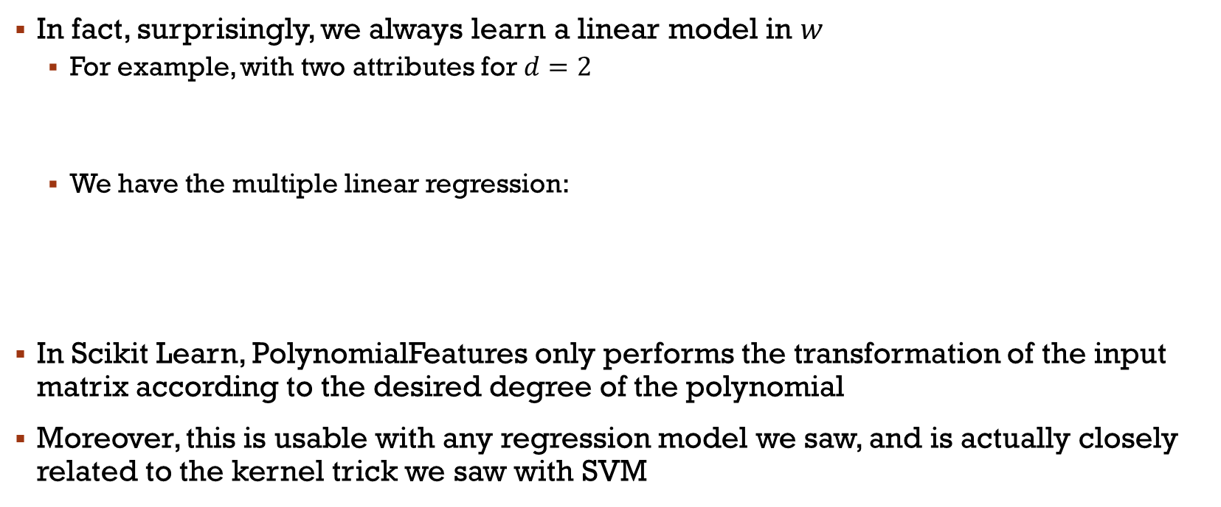
Polynomial regression
In fact, surprisingly, we always learn a linear model in $w$
For example, with two attributes for $d=2$
We have the multiple linear regression:
In Scikit Learn, PolynomialFeatures only performs the transformation of the input matrix according to the desired degree of the polynomial
Moreover, this is usable with any regression model we saw, and is actually closely related to the kernel trick we saw with SVM

Slide 11
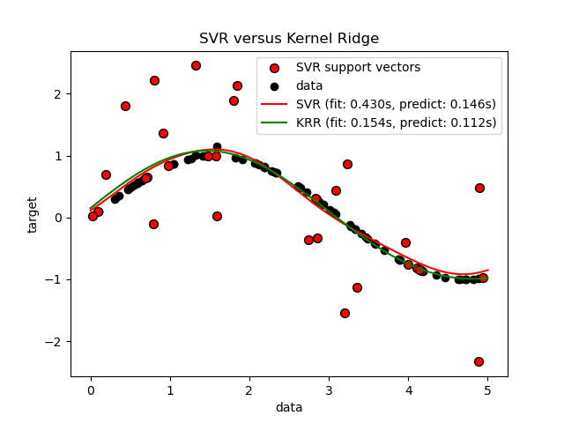
Kernel ridge regression
Kernel Ridge Regression (KRR) is an algorithm used in machine learning that combines ridge regression
KernelRidge is identical to SVR, however, different loss functions are used
KRR uses squared error loss
KRR is often faster on smaller datasets
KRR learnt model is non-sparse (few zeroes) and is, therefore, slower

Slide 12



Classification and Regression Trees
The CART algorithm supports regressions in addition to classification
To use it in Scikit-Learn, we call DecisionTreeRegressor
The main modification consists of replacing the impurity measure with the mean squared error (MSE)
x: feature, D: dataset, N: samples
with
Notes:
IG= Gain

Slide 13
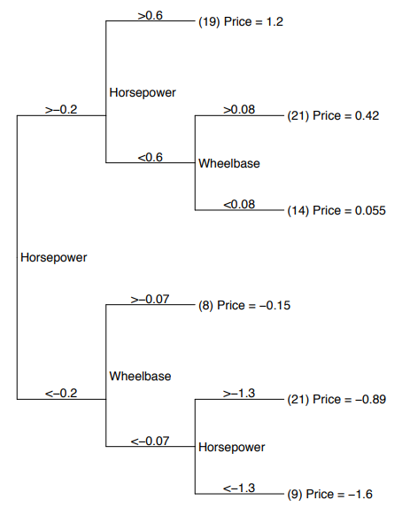
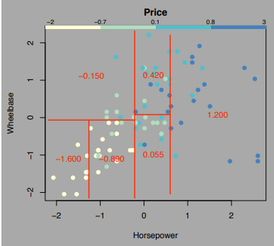
Example

Slide 14
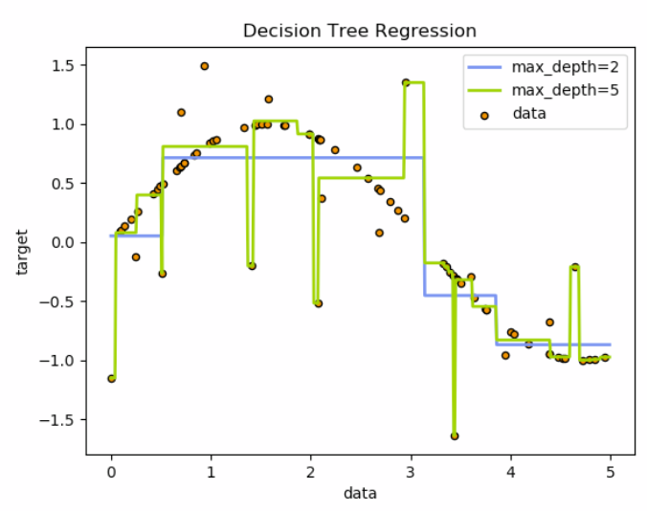
Exemple 2
https://scikit-learn.org/stable/auto_examples/tree/plot_tree_regression.html#sphx-glr-auto-examples-tree-plot-tree-regression-py
Notes:
Discussion?

Slide 15
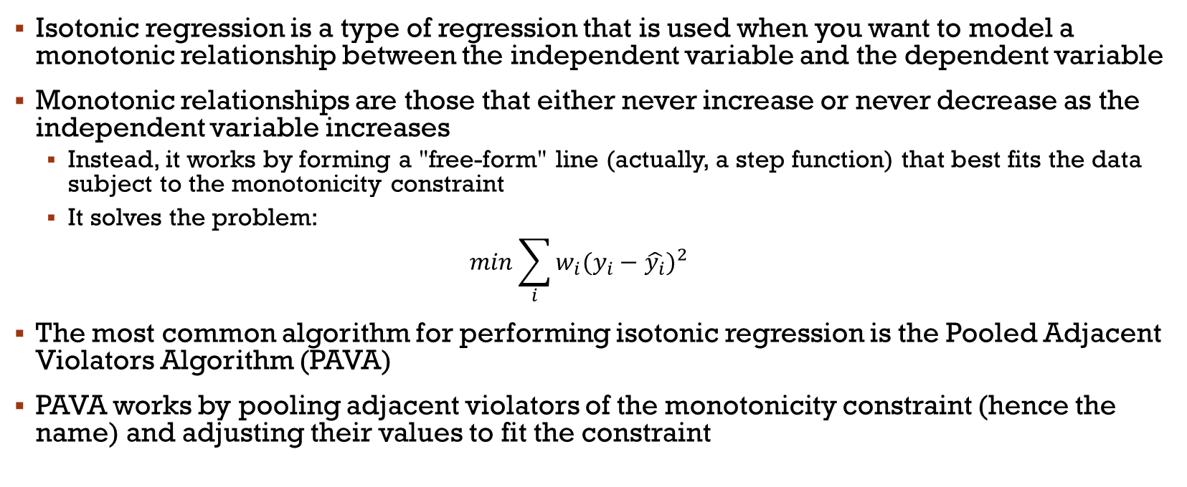
Isotonic Regression
Isotonic regression is a type of regression that is used when you want to model a monotonic relationship between the independent variable and the dependent variable
Monotonic relationships are those that either never increase or never decrease as the independent variable increases
Instead, it works by forming a "free-form" line (actually, a step function) that best fits the data subject to the monotonicity constraint
It solves the problem:
$$min\sum_{i}{w_{i}{(y_{i}−\hat{y_{i}})}^{2}}$$
The most common algorithm for performing isotonic regression is the Pooled Adjacent Violators Algorithm (PAVA)
PAVA works by pooling adjacent violators of the monotonicity constraint (hence the name) and adjusting their values to fit the constraint

Slide 16
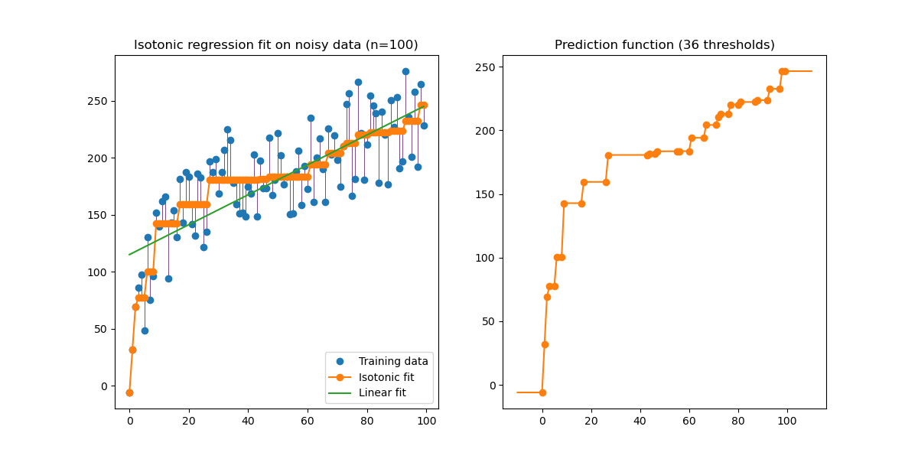
Isotonic Regression

Slide 17
Isotonic Regression
Isotonic regression is used for nonmetric multidimensional scaling, where a low-dimensional embedding for data points is sought such that order of distances between points in the embedding matches order of dissimilarity between point
We’ll see better method to do so, however
Isotonic regression is also used in probabilistic classification to calibrate the predicted probabilities of supervised ML models
Calibration refers to the process of adjusting the predicted probabilities to better reflect the true likelihood of the outcomes
Well-calibrated probabilities should represent the true probability of the event of interest
Basically, we train an isotonic regression model to adjust the predicted probabilities to the real probabilities
Then, the model is used to map the original predicted probabilities to new, calibrated probabilities

Slide 18
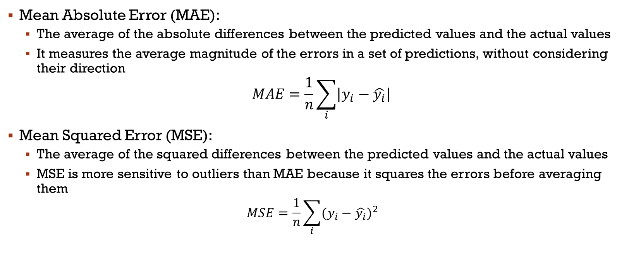
Common evaluation measures
Mean Absolute Error (MAE):
The average of the absolute differences between the predicted values and the actual values
It measures the average magnitude of the errors in a set of predictions, without considering their direction
$$MAE=\frac{1}{n}\sum_{i}{\left|y_{i}−\hat{y_{i}}\right|}$$
Mean Squared Error (MSE):
The average of the squared differences between the predicted values and the actual values
MSE is more sensitive to outliers than MAE because it squares the errors before averaging them
$$MSE=\frac{1}{n}\sum_{i}{{(y_{i}−\hat{y_{i}})}^{2}}$$

Slide 19
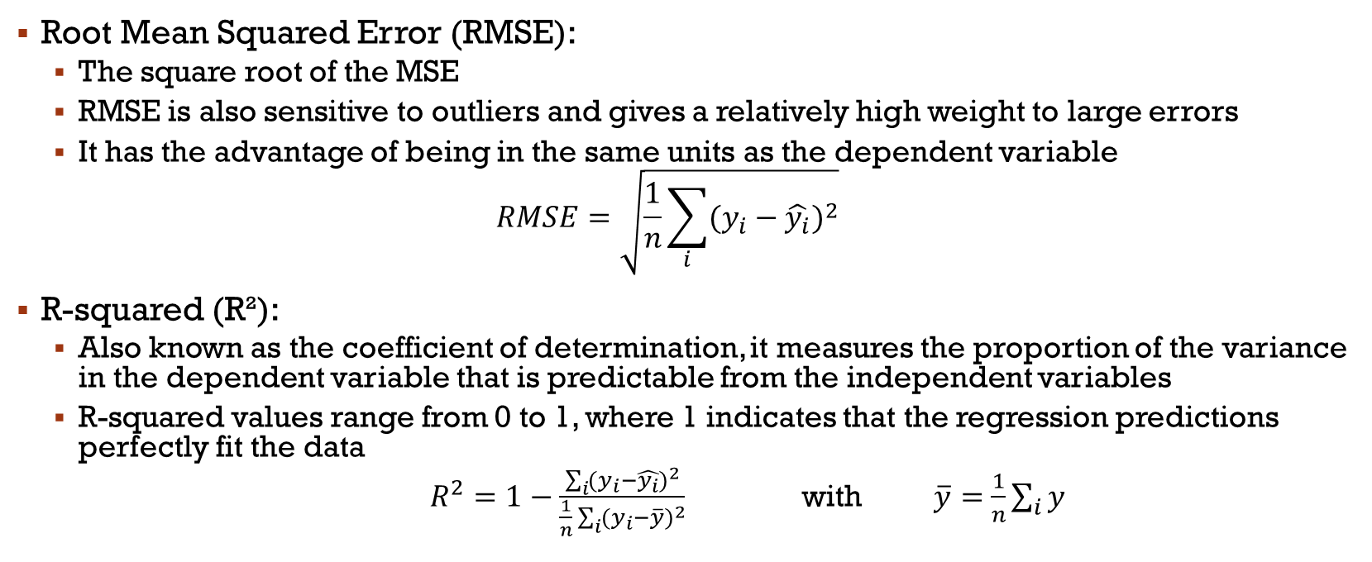
Common evaluation measures
Root Mean Squared Error (RMSE):
The square root of the MSE
RMSE is also sensitive to outliers and gives a relatively high weight to large errors
It has the advantage of being in the same units as the dependent variable
$$RMSE=\sqrt{\frac{1}{n}\sum_{i}{{(y_{i}−\hat{y_{i}})}^{2}}}$$
R-squared (R²):
Also known as the coefficient of determination, it measures the proportion of the variance in the dependent variable that is predictable from the independent variables
R-squared values range from 0 to 1, where 1 indicates that the regression predictions perfectly fit the data
$R^{2}=1−\frac{\sum_{i}{{(y_{i}−\hat{y_{i}})}^{2}}}{\frac{1}{n}\sum_{i}{{(y_{i}−\overline{y})}^{2}}}$ with $\overline{y}=$ $\frac{1}{n}\sum_{i}{y}$

Slide 20
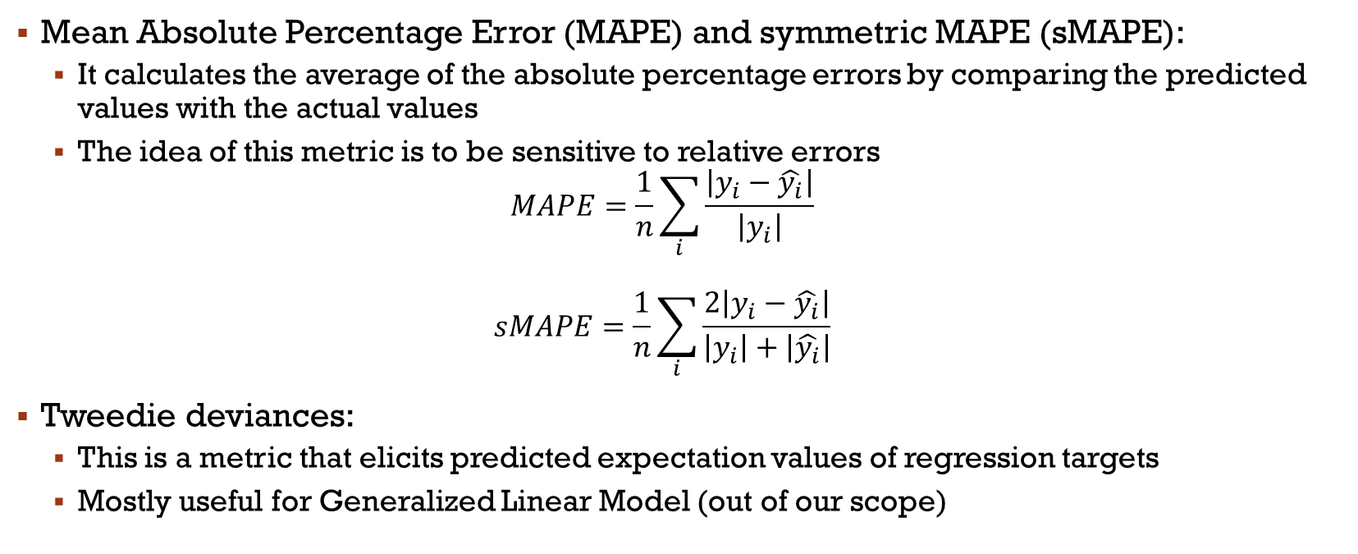
Common evaluation measures
Mean Absolute Percentage Error (MAPE) and symmetric MAPE (sMAPE):
It calculates the average of the absolute percentage errors by comparing the predicted values with the actual values
The idea of this metric is to be sensitive to relative errors
$$MAPE=\frac{1}{n}\sum_{i}{\frac{\left|y_{i}−\hat{y_{i}}\right|}{\left|y_{i}\right|}}$$ $$sMAPE=\frac{1}{n}\sum_{i}{\frac{2\left|y_{i}−\hat{y_{i}}\right|}{\left|y_{i}\right|+\left|\hat{y_{i}}\right|}}$$
Tweedie deviances:
This is a metric that elicits predicted expectation values of regression targets
Mostly useful for Generalized Linear Model (out of our scope)

Slide 21
Main References
Russell S., Norvig P., Artificial Intelligence: A Modern Approach. Prentice-Hall, Englewood Cliffs, 2021.
Aggarwal, C. C., Neural networks and deep learning. Springer, 2023.
Goodfellow I., Bengio Y., Deep Learning. The MIT Press, 2016.
Raschka S., Python Machine Learning, Packt Publishing, 2015.
Sutton R.S., Barto A.G., Reinforcement Learning: An Introduction, A Bradford Book, 2021.
Witten I.H., Frank E., Hall M.A., Pal C. Data Mining: Practical Machine Learning Tools and Techniques, Morgan Kaufmann, 2016.

